Slide 1
Making Custom Dataset using Auto-labeling
Preparing a custom dataset in PASCAL VOC format for the EDGE Computing
course project using an auto-labeling technique to avoid manually labeling every image.
github: https://github.com/bxod/edge_dataset_make

Slide 2
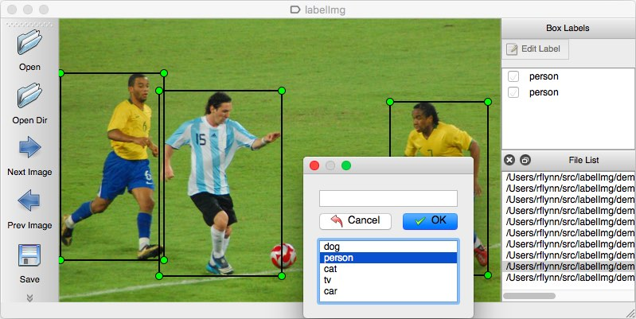
The problem
We have seen labeling the images and creating an XML file manually
However, for robust model training we need thousands of images for each class
Manual labeling of thousand of images takes huge amount of time

Slide 3
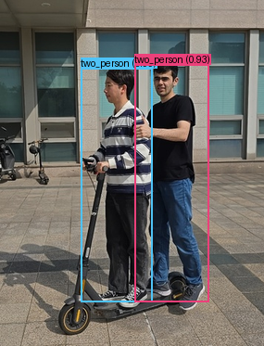
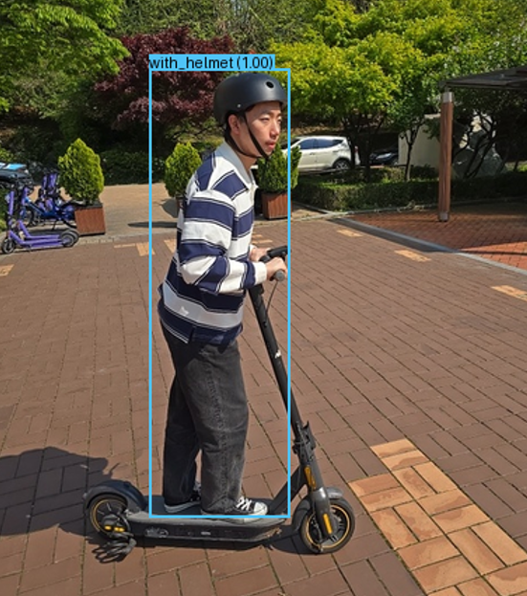
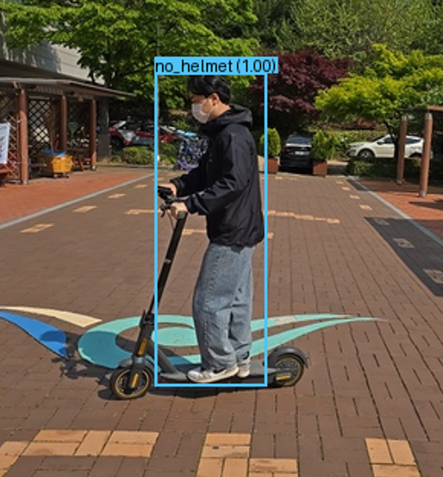
Dataset Classes
For this project, our goal is to build a dataset with the following classes:
no_helmet: a kick scooter rider without a helmet
with_helmet: a kick scooter rider wearing a helmet
two_person: two persons riding the same kick scooter
This presentation covers the following steps:
1. Collecting and formatting images
2. Shuffling and renaming the images
3. Auto-labeling and creating XML files using YoloV8 model

Slide 4

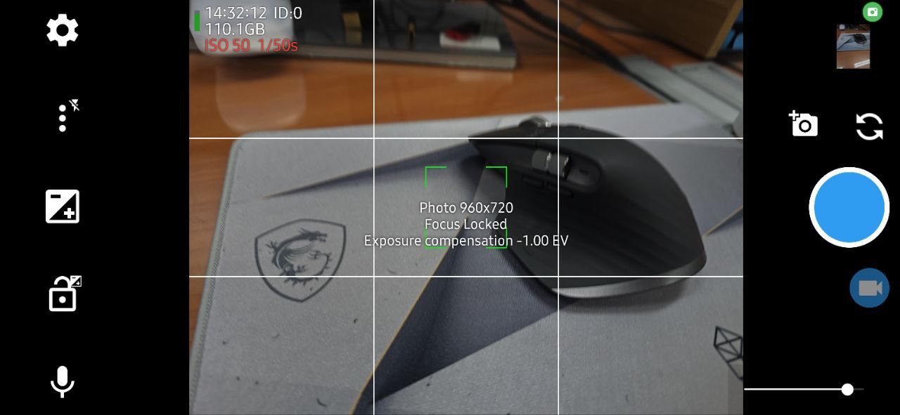
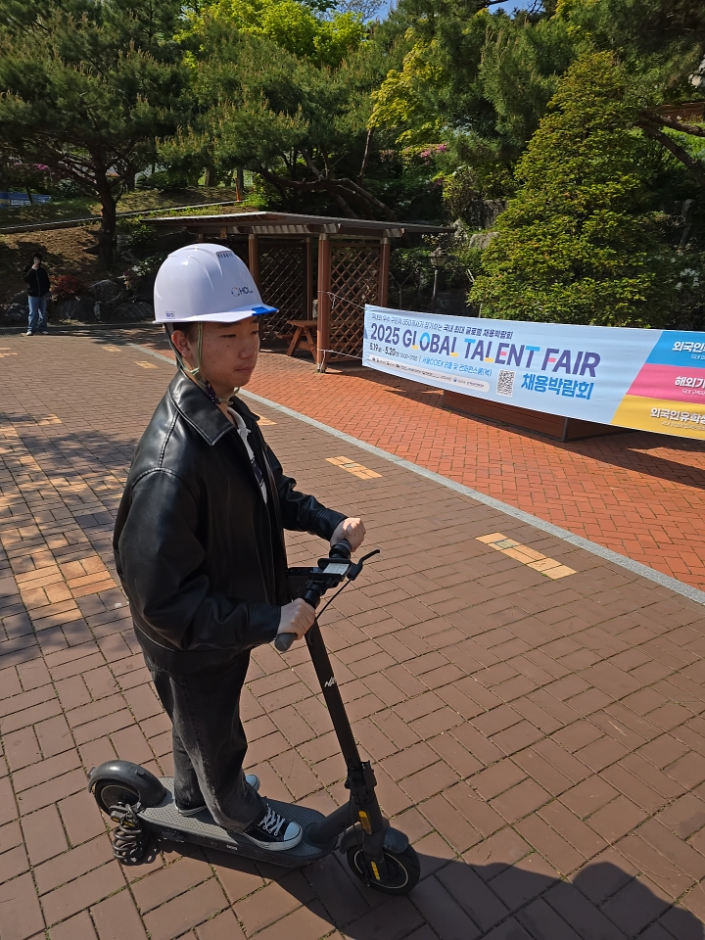
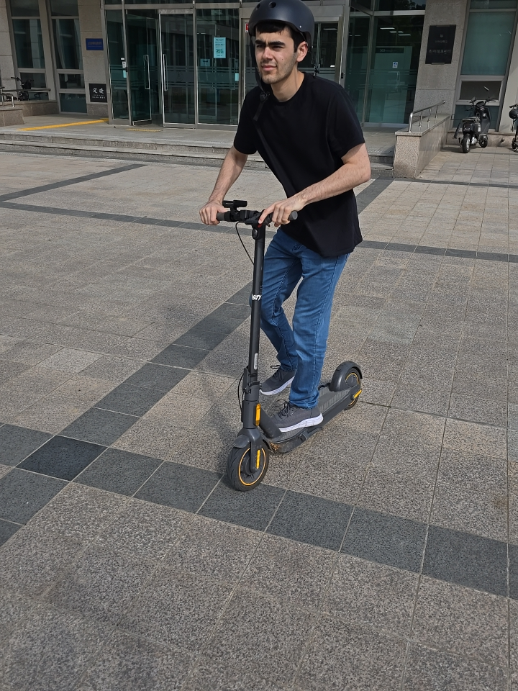
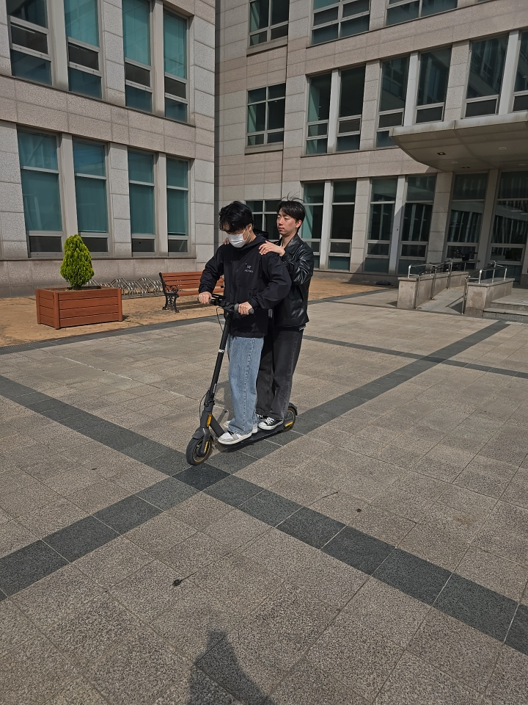
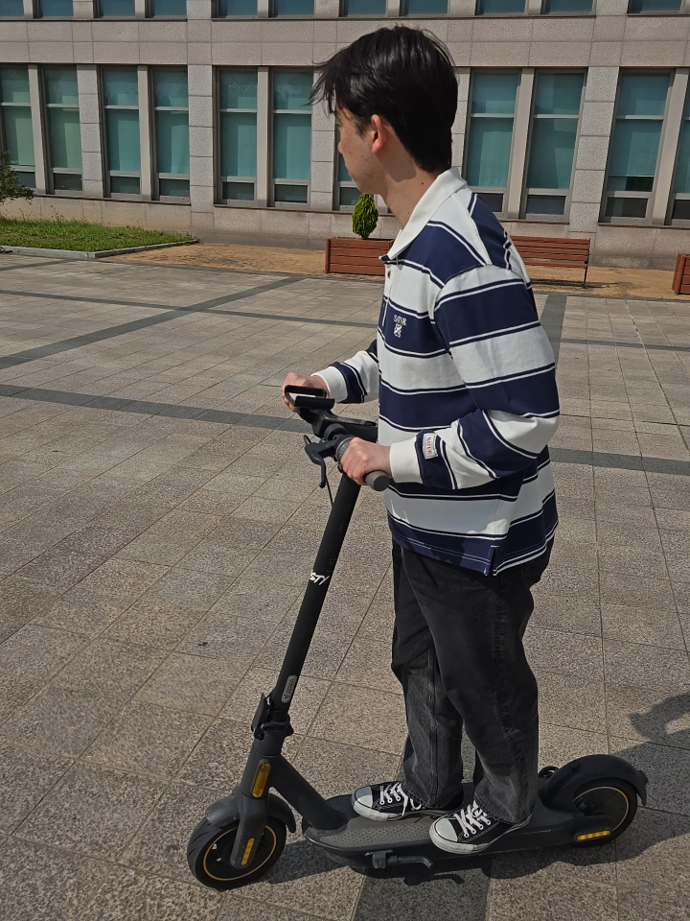
Data preparation
Capture images with the resolution in the range: 512x512 and 1080x1080 resolution in JPG format using your phone.
Preferrably, capture images in landscape mode (width>height)
We used the “Open Camera” Android app to capture 960×720 images.
We captured over 3,000 images across the three classes, ensuring varied backgrounds and clothing for model robustness.

Slide 5
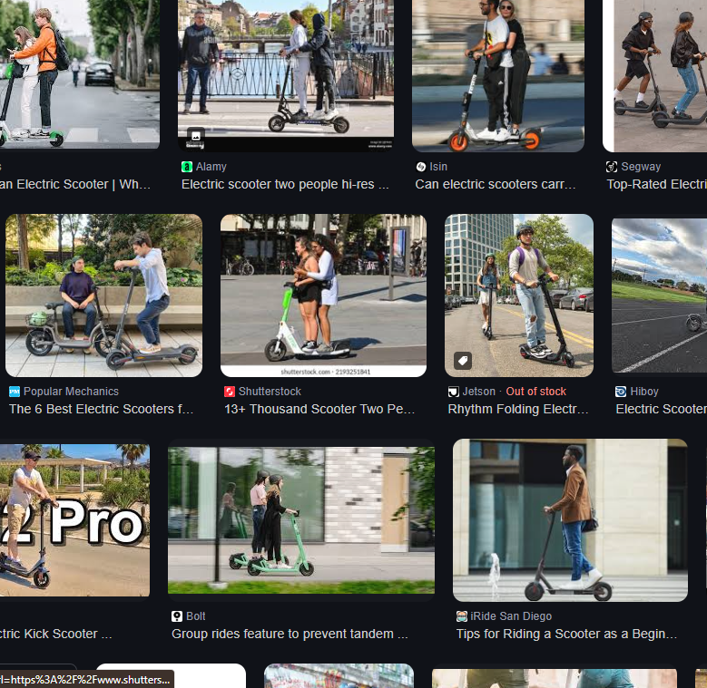
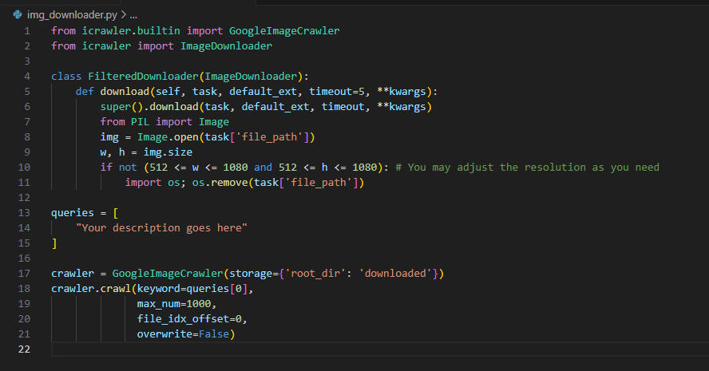
Data preparation
We downloaded an additional 400 images in total for three classes from Google using img_downloader.py.

Slide 6
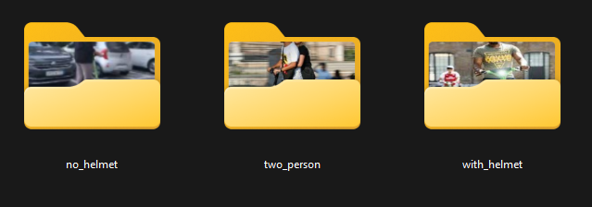
Folder organization
We now have around 3,500 images for three classes.
Place all images in three separate folders under the dataset root:
dataset_root/
├── no_helmet/ (1,034 images)
├── with_helmet/ (1,615 images)
└── two_person/ (762 images)
Ensure all images are in .jpg format and within the 512×512 to 1080×1080 pixel range to match the SSDLite320–640 input requirements.

Slide 7
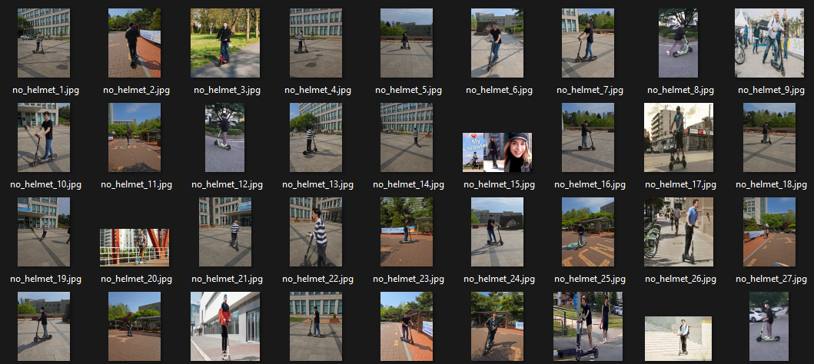
Shuffling and Renaming
Use shuffler.py to randomly shuffle images within each class folder and rename them as {class_name}_{order}.jpg
This step will prevent overfit and makes the model more robust
Run:
python shuffler.py
# Will rename images inside the given folder. E.g. with_helmet_1.jpg, with_helmet_2.jpg, ...

Slide 8
Auto-Labeling
Install the following packages:
pip install ultralytics
pip install pillow
Make sure you have CUDA available if you are going to use GPU for auto detecting objects
python -c "import torch; print(torch.cuda.is_available())"
Create XML files
Now run xml_maker.py to create XML labels for each class folder. Make sure you pass correct dataset root that contains the class folders with images e.g. ./dataset_root
python xml_maker.py

Slide 9
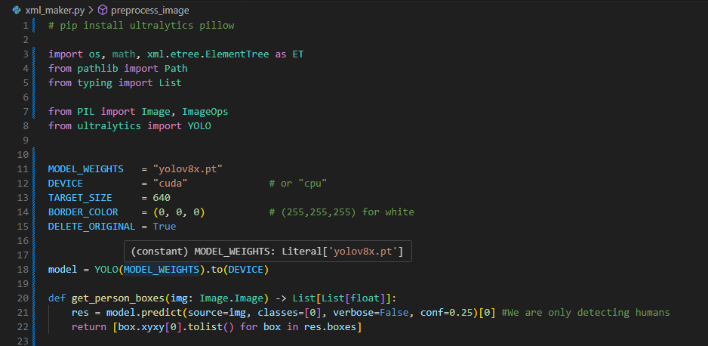
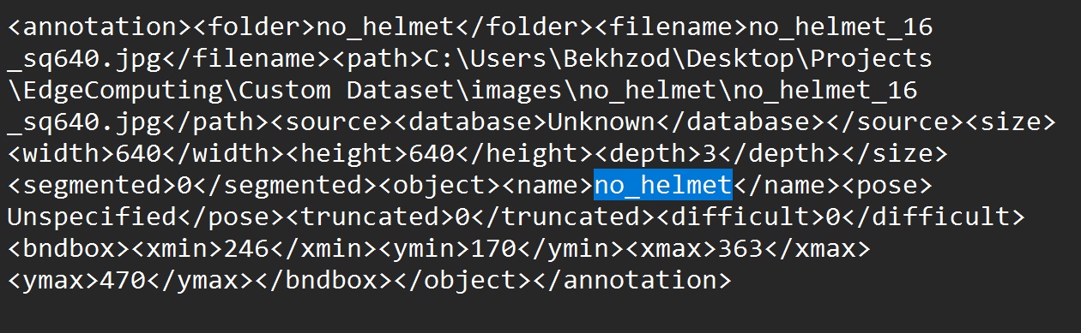
xml_maker.py
There are lack of models that detect classes no_helmet, with_helmet, two_person for kick-scooter riders.
So, we have to only detect humans in each class folder and label that image with the folder name
E.g., XML files inside the /with_helmet folder will will be given the class /with_helmet along with the position of the humans inside the corresponding image
You will now have XML label files created next to each image file. You can now split the dataset into train, test, validation subfolders according to PASCAL VOC format. In our case, we splitted with the ration 8:1:1 for train, test, validation respectively.
XML file compatible with PASCAL VOC training code

Slide 10
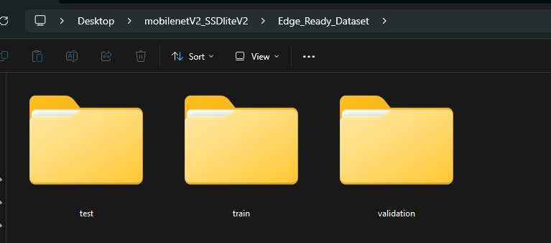
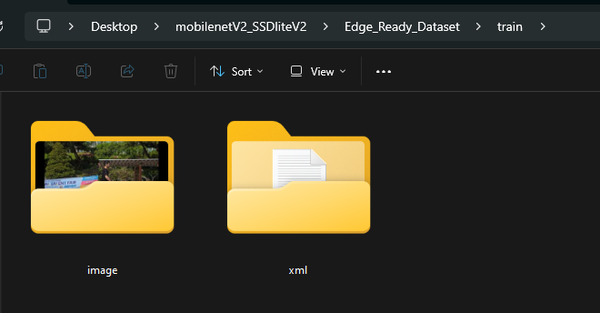
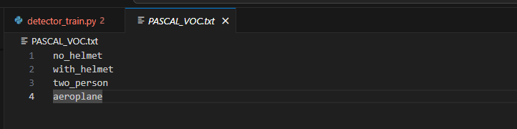
Final steps
Your final dataset should look like this:
parent folder
train folder
You can now place the parent folder inside your PASCAL VOC trainer project and change the PASCAL_VOC.txt file to include your dataset classes.

Slide 11
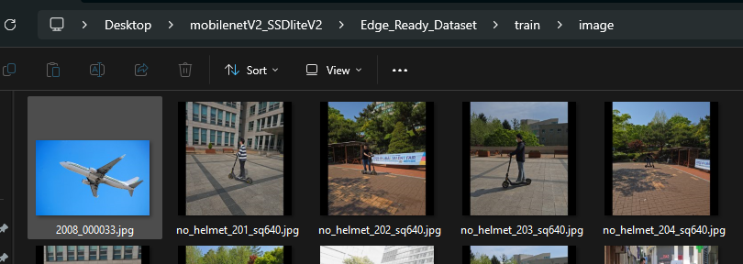
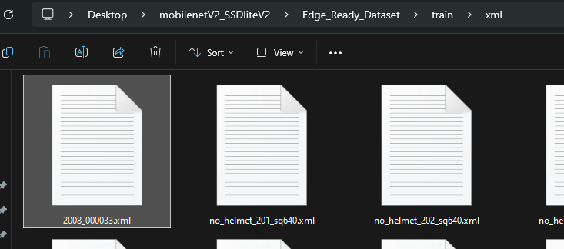
Notes
The trainer project does NOT allow less than 4 classes. So if your dataset contains three classes, you should create a dummy 4th class with one image and its xml file in train, test, validation folder. It will not affect other classes.

Slide 12
Github
github: https://github.com/bxod/edge_dataset_make

